Slide 1
Lecture 6
PA=LU decomposition

Slide 2
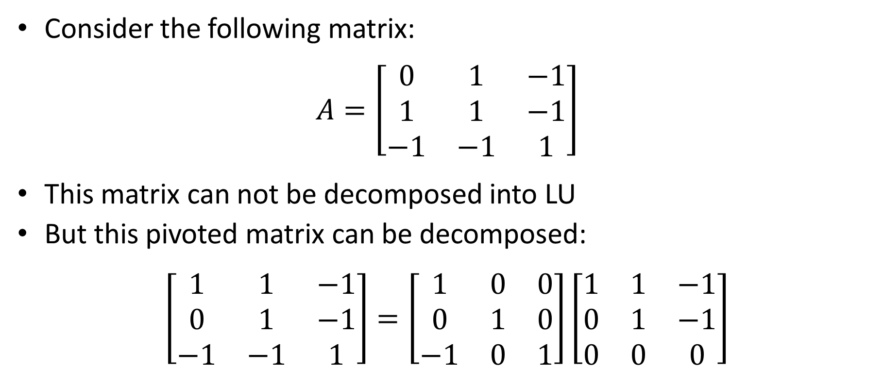
Introduction
Consider the following matrix:
$$A=\left[\begin{matrix}0 & 1 & −1 \\ 1 & 1 & −1 \\ −1 & −1 & 1\end{matrix}\right]$$
This matrix can not be decomposed into LU
But this pivoted matrix can be decomposed:
$$\left[\begin{matrix}1 & 1 & −1 \\ 0 & 1 & −1 \\ −1 & −1 & 1\end{matrix}\right]=\left[\begin{matrix}1 & 0 & 0 \\ 0 & 1 & 0 \\ −1 & 0 & 1\end{matrix}\right]\left[\begin{matrix}1 & 1 & −1 \\ 0 & 1 & −1 \\ 0 & 0 & 0\end{matrix}\right]$$
Notes:
In previous lectures we learned to find the LU decomposition of a square matrix
But consider the displayed matrix A
This matrix can not be decomposed into LU
The reason is the zero in position a11.
This zero leads to a division by zero in the algorithm.
But if we switch the first two rows of the matrix A, we can decompose it into LU.
I invite you to try to find this decomposition by yourselves.

Slide 3
Introduction
Recall that we introduced partial pivoting strategy in the Gauss algorithm to avoid numerical problems
How can we implement partial pivoting in the LU decomposition ?
This can be done with the help of permutation matrices
Notes:
Recall that we introduced partial pivoting strategy in the Gauss algorithm to avoid numerical problems such as divisions by zero.
If we use the same idea in the LU decomposition algorithm, we should be able to avoid numerical problems in the LU decomposition algorithm too.
How can we implement partial pivoting in the LU decomposition ?
This can be done with the help of permutation matrices

Slide 4







Permutation Matrix
Definition
A permutation matrix $P$ is a matrix consisting of all zeros, except for a single 1 in every row and column.
Examples:
$$\left[\begin{matrix}1 & 0 & 0 \\ 0 & 1 & 0 \\ 0 & 0 & 1\end{matrix}\right]$$
$$\left[\begin{matrix}0 & 1 & 0 \\ 1 & 0 & 0 \\ 0 & 0 & 1\end{matrix}\right]$$
$$\left[\begin{matrix}0 & 0 & 1 \\ 0 & 1 & 0 \\ 1 & 0 & 0\end{matrix}\right]$$
$$\left[\begin{matrix}1 & 0 & 0 \\ 0 & 0 & 1 \\ 0 & 1 & 0\end{matrix}\right]$$
$$\left[\begin{matrix}0 & 0 & 1 \\ 1 & 0 & 0 \\ 0 & 1 & 0\end{matrix}\right]$$
$$\left[\begin{matrix}0 & 1 & 0 \\ 0 & 0 & 1 \\ 1 & 0 & 0\end{matrix}\right]$$
Notes:
What is a permutation matrix?
The definition reads
A permutation matrix $P$ is a matrix consisting of all zeros, except for a single 1 in every row and column.
For 3x3 matrices there exist exactly 6 permutation matrices as displayed.
Of course the identity matrix is always a permutation matrix. The five others look similar to the identity matrix but of course are not the same.

Slide 5
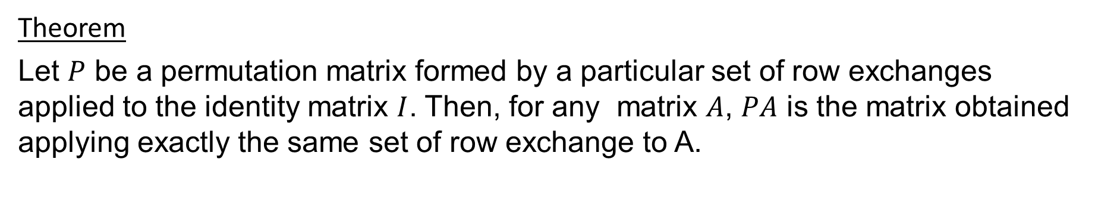

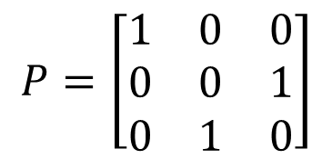
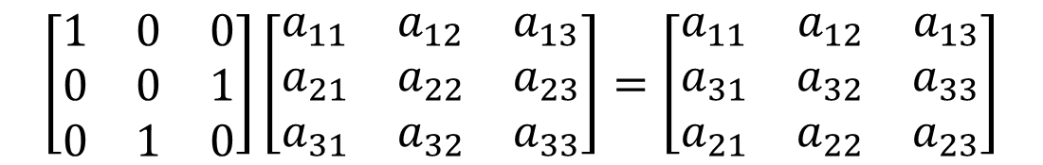
Main Property of a Permutation Matrix
Theorem
Let $P$ be a permutation matrix formed by a particular set of row exchanges applied to the identity matrix $I$. Then, for any matrix $A$, $PA$ is the matrix obtained applying exactly the same set of row exchange to A.
$$I=\left[\begin{matrix}1 & 0 & 0 \\ 0 & 1 & 0 \\ 0 & 0 & 1\end{matrix}\right]$$
$$P=\left[\begin{matrix}1 & 0 & 0 \\ 0 & 0 & 1 \\ 0 & 1 & 0\end{matrix}\right]$$
$$\left[\begin{matrix}1 & 0 & 0 \\ 0 & 0 & 1 \\ 0 & 1 & 0\end{matrix}\right]\left[\begin{matrix}a_{11} & a_{12} & a_{13} \\ a_{21} & a_{22} & a_{23} \\ a_{31} & a_{32} & a_{33}\end{matrix}\right]=\left[\begin{matrix}a_{11} & a_{12} & a_{13} \\ a_{31} & a_{32} & a_{33} \\ a_{21} & a_{22} & a_{23}\end{matrix}\right]$$
Notes:
Permutation matrices have several interesting properties.
For our purpose we will use one of them as stated in the theorem
The theorem reads:
Let $P$ be a permutation matrix formed by a particular set of row exchanges applied to the identity matrix $I$. Then, for any matrix $A$, $PA$ is the matrix obtained applying exactly the same set of row exchange to A.
For example if we switch the last two rows of the 3x3 identity matrix we get the permutation matrix P displayed.
Let us now multiply a general 3x3 matrix by P.
You will note the obtained result is the original matrix where the last two rows were switched.

Slide 6

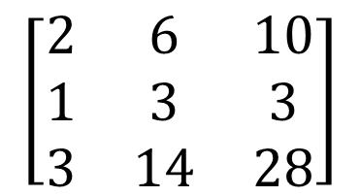

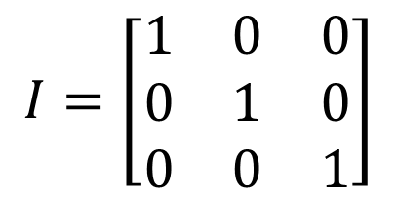

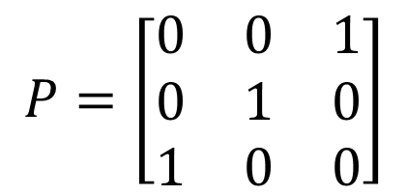
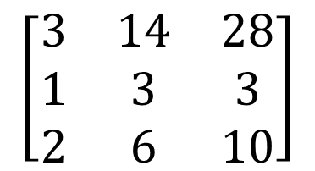
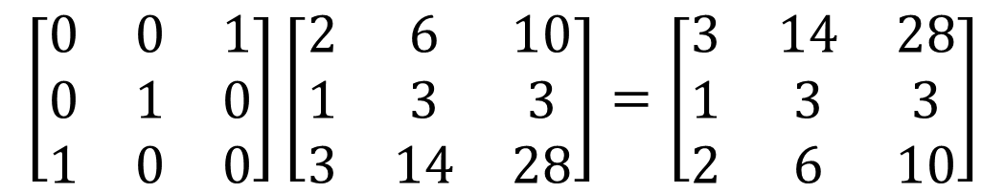

Encoding Pivoting with Permutation Matrices
$$\left[\begin{matrix}2 & 6 & 10 \\ 1 & 3 & 3 \\ 3 & 14 & 28\end{matrix}\right]$$
$$\left[\begin{matrix}3 & 14 & 28 \\ 1 & 3 & 3 \\ 2 & 6 & 10\end{matrix}\right]$$
$$I=\left[\begin{matrix}1 & 0 & 0 \\ 0 & 1 & 0 \\ 0 & 0 & 1\end{matrix}\right]$$
$$P=\left[\begin{matrix}0 & 0 & 1 \\ 0 & 1 & 0 \\ 1 & 0 & 0\end{matrix}\right]$$
$$A$$
same
$$\left[\begin{matrix}0 & 0 & 1 \\ 0 & 1 & 0 \\ 1 & 0 & 0\end{matrix}\right]\left[\begin{matrix}2 & 6 & 10 \\ 1 & 3 & 3 \\ 3 & 14 & 28\end{matrix}\right]=\left[\begin{matrix}3 & 14 & 28 \\ 1 & 3 & 3 \\ 2 & 6 & 10\end{matrix}\right]$$
$$P$$
$$A$$
$$PA$$
Notes:
Permutation matrices are used to encode the pivoting step in the Gauss elimination algorithm with partial pivoting
Consider the displayed A matrix and let us apply the pivoting strategy we used in the Gauss algorithm
Scanning the first column tells us that row one and three must be switched.
This leads us to a new pivoted coefficient matrix.
If we want to encode this witching we can do it using the appropriate permutation matrix
To find this matrix we start from the identity matrix and do exactly the switching we did on A.
In our case we exchange row 1 and 3.
This gives us our permutation matrix P
The product PA gives us exactly the switched matrix A we obtained in the Gauss elimination algorithm with partial pivoting

Slide 7

Example
Find the $PA=LU$ decomposition of the following matrix:
$$A=\left[\begin{matrix}2 & 6 & 10 \\ 1 & 3 & 3 \\ 3 & 14 & 28\end{matrix}\right]$$
Notes:
Let us show with an example how the Gauss elimination with partial pivoting algorithm translates into the PA=LU decomposition
For this we want to decompose the displayed matrix A into PA=LU.

Slide 8



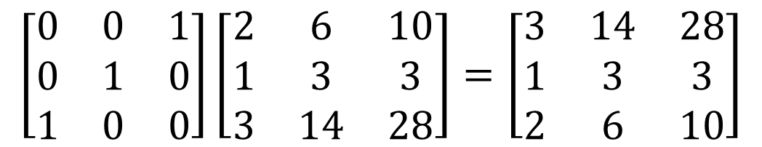

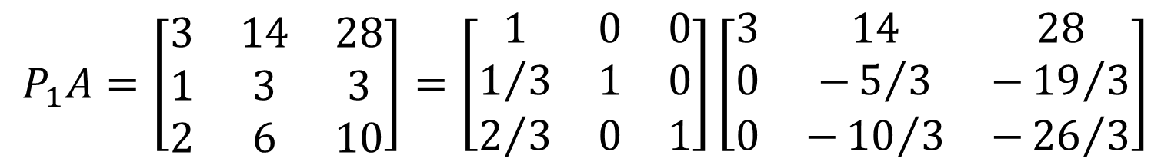


Example
Pivoting strategy:
Gauss elimination on pivoted matrix $P_{1}A$
$$\left[\begin{matrix}2 & 6 & 10 \\ 1 & 3 & 3 \\ 3 & 14 & 28\end{matrix}\right]$$
$$\left[\begin{matrix}0 & 0 & 1 \\ 0 & 1 & 0 \\ 1 & 0 & 0\end{matrix}\right]\left[\begin{matrix}2 & 6 & 10 \\ 1 & 3 & 3 \\ 3 & 14 & 28\end{matrix}\right]=\left[\begin{matrix}3 & 14 & 28 \\ 1 & 3 & 3 \\ 2 & 6 & 10\end{matrix}\right]$$
$$A$$
$$P_{1}$$
$$A$$
$$P_{1}A$$
$$P_{1}A=\left[\begin{matrix}3 & 14 & 28 \\ 1 & 3 & 3 \\ 2 & 6 & 10\end{matrix}\right]=\left[\begin{matrix}1 & 0 & 0 \\ 1/3 & 1 & 0 \\ 2/3 & 0 & 1\end{matrix}\right]\left[\begin{matrix}3 & 14 & 28 \\ 0 & −5/3 & −{19}/3 \\ 0 & −{10}/3 & −{26}/3\end{matrix}\right]$$
Notes:
We start by applying the pivoting strategy
Scanning the first column of A shows us that row 1 and 3 must be switched
This is achieved with the permutation matrix P obtained from the unity matrix where row one and three were switched.
After the pivoting strategy we proceed with Gauss elimination
We do this on the pivoted matrix P1A the way we learned it with the LU decomposition
For this we identify the needed entries in the future L and U matrix.
The entry 1/3 was obtained because we have to remove one over three times row 1 from row two in order to obtain a zero in the first column of U.
Similarly the entry 2/3 is obtained because we have to remove two over three times row 1 from row two in order to obtain a zero in the first column of U.
The entries in the future U matrix are obtained by executing the identified row operations

Slide 9
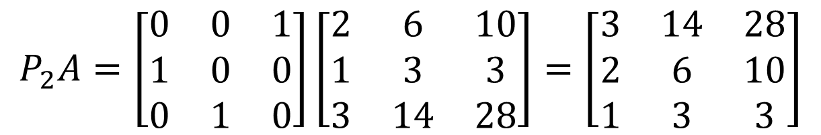







Example
Pivoting strategy:
New pivoted matrix $P_{2}A$
$$\left[\begin{matrix}3 & 14 & 28 \\ 0 & −5/3 & −{19}/3 \\ 0 & −{10}/3 & −{26}/3\end{matrix}\right]$$
$$\left[\begin{matrix}0 & 0 & 1 \\ 0 & 1 & 0 \\ 1 & 0 & 0\end{matrix}\right]$$
$$\left[\begin{matrix}0 & 0 & 1 \\ 1 & 0 & 0 \\ 0 & 1 & 0\end{matrix}\right]$$
$$P_{1}A$$
$$P_{1}$$
$$P_{2}$$
$$P_{2}A=\left[\begin{matrix}0 & 0 & 1 \\ 1 & 0 & 0 \\ 0 & 1 & 0\end{matrix}\right]\left[\begin{matrix}2 & 6 & 10 \\ 1 & 3 & 3 \\ 3 & 14 & 28\end{matrix}\right]=\left[\begin{matrix}3 & 14 & 28 \\ 2 & 6 & 10 \\ 1 & 3 & 3\end{matrix}\right]$$
Notes:
We proceed by another pivoting step
Scanning the second column starting from the pivot element tells us that we have to switch row 2 and 3
This is encoded in the P matrix by exchanging row 2 and 3 on the matrix P1 to transform it into P2.
Computing P2 times A gives us indeed the new pivoted matrix
The fact we needed to further switch row 2 and 3 is kind of bad news for us.
It means that the switching between row 1 and 2 we did previously was not enough.
Decomposing the pivoted matrix P1A into LU was not the correct thing to do.
We should have decomposed the pivoted matrix P2A
Note that before proceeding with the Gauss elimination on P1A it was impossible to know that we in fact needed one more pivoting step.

Slide 10

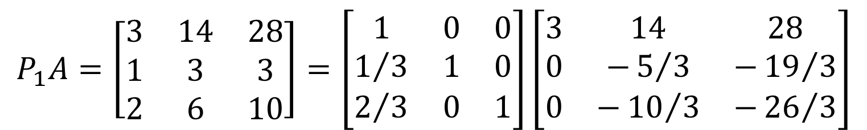
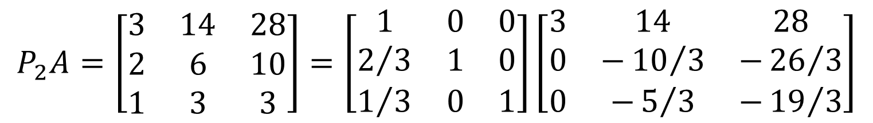
Example
Gauss elimination on pivoted matrix $P_{2}A$
$$P_{2}A=\left[\begin{matrix}3 & 14 & 28 \\ 2 & 6 & 10 \\ 1 & 3 & 3\end{matrix}\right]=\left[\begin{matrix}1 & 0 & 0 \\ 2/3 & 1 & 0 \\ 1/3 & 0 & 1\end{matrix}\right]\left[\begin{matrix}3 & 14 & 28 \\ 0 & −{10}/3 & −{26}/3 \\ 0 & −5/3 & −{19}/3\end{matrix}\right]$$
$$P_{1}A=\left[\begin{matrix}3 & 14 & 28 \\ 1 & 3 & 3 \\ 2 & 6 & 10\end{matrix}\right]=\left[\begin{matrix}1 & 0 & 0 \\ 1/3 & 1 & 0 \\ 2/3 & 0 & 1\end{matrix}\right]\left[\begin{matrix}3 & 14 & 28 \\ 0 & −5/3 & −{19}/3 \\ 0 & −{10}/3 & −{26}/3\end{matrix}\right]$$
Notes:
Let us proceed with the Gauss elimination on the pivoted P2A matrix
Do we really have to re-do all calculations from scratch?
Luckily no.
We only need to switch the boxed elements from our pervious calculations
Indeed recall how looked the Gauss elimination on the pivoted P1A matrix
Note how the boxed elements are simply exchanged compared to the decomposition of P2A

Slide 11
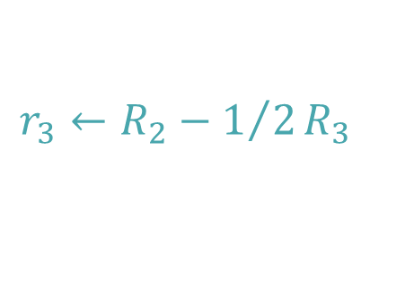
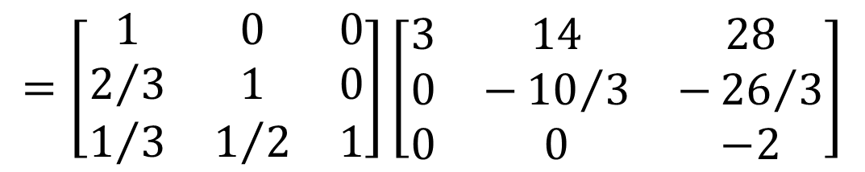
Example
Gauss elimination on pivoted matrix $P_{2}A$
$$P_{2}A=\left[\begin{matrix}3 & 14 & 28 \\ 2 & 6 & 10 \\ 1 & 3 & 3\end{matrix}\right]=\left[\begin{matrix}1 & 0 & 0 \\ 2/3 & 1 & 0 \\ 1/3 & 0 & 1\end{matrix}\right]\left[\begin{matrix}3 & 14 & 28 \\ 0 & −{10}/3 & −{26}/3 \\ 0 & −5/3 & −{19}/3\end{matrix}\right]$$
$$r_{3}←R_{2}−1/2R_{3}$$
$$=\left[\begin{matrix}1 & 0 & 0 \\ 2/3 & 1 & 0 \\ 1/3 & 1/2 & 1\end{matrix}\right]\left[\begin{matrix}3 & 14 & 28 \\ 0 & −{10}/3 & −{26}/3 \\ 0 & 0 & −2\end{matrix}\right]$$
Notes:
We finish the algorithm by conducting the Gauss elimination step
For this we work on the highlighted sub-matrix.
To obtain a zero in the U matrix we have to remove 1 over 2 times row 3 from row 2
This gives us the last needed entry in the L matrix
The U matrix is obtained by executing the identified row operation

Slide 12
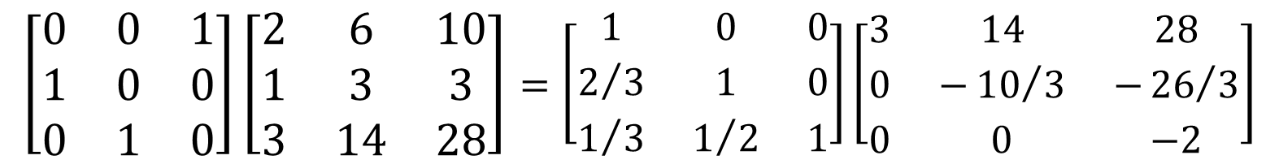




Example
Putting all together:
$$\left[\begin{matrix}0 & 0 & 1 \\ 1 & 0 & 0 \\ 0 & 1 & 0\end{matrix}\right]\left[\begin{matrix}2 & 6 & 10 \\ 1 & 3 & 3 \\ 3 & 14 & 28\end{matrix}\right]=\left[\begin{matrix}1 & 0 & 0 \\ 2/3 & 1 & 0 \\ 1/3 & 1/2 & 1\end{matrix}\right]\left[\begin{matrix}3 & 14 & 28 \\ 0 & −{10}/3 & −{26}/3 \\ 0 & 0 & −2\end{matrix}\right]$$
$$P$$
$$A$$
$$L$$
$$U$$
Notes:
We can now right down the result

Slide 13


Using Octave / Matlab
The $PA=LU$ is implemented in octave with the “lu” command
Example:
Find the $PA=LU$ decomposition of
octave> A=[2 6 10; 1 3 3; 3 14 28];
octave> [L U P] = lu(A)
L =
1.00000 0.00000 0.00000
0.66667 1.00000 0.00000
0.33333 0.50000 1.00000
U =
3.00000 14.00000 28.00000
0.00000 -3.33333 -8.66667
0.00000 0.00000 -2.00000
P =
Permutation Matrix
0 0 1
1 0 0
0 1 0
$$A=\left[\begin{matrix}2 & 6 & 10 \\ 1 & 3 & 3 \\ 3 & 14 & 28\end{matrix}\right]$$
Notes:
In octave or matlab, the PA=LU decomposition is implemented with the LU command
We illustrate its usage with the displayed A matrix
First we enter the matrix A in octave into a variable named A.
Let lu command has several possible syntaxes depending on what you desire to calculate. I invite you to read the related help information.
For our purpose we use it in the form where it returns three matrices.
The first one is the permutation matrix, which we name P
The second is the upper diagonal matrix which we name U
And the third is the lower diagonal matrix which we name L.
Executing the command gives us the expected answers.
You will note that octave computes the same matrices as we did in our example.

Slide 14

Summary
The partial pivoting strategy in Gauss elimination is implemented using permutation matrices
The $PA=LU$ decomposition incorporates the Gauss elimination algorithm with partial pivoting
Notes:
Let us summarize the key findings
The partial pivoting strategy in Gauss elimination is implemented using permutation matrices
The $PA=LU$ decomposition incorporates the Gauss elimination algorithm with partial pivoting

